Slide 1

Pinedo Spanish LLC
Exploratory data analysis
by
Jesus Acevedo

Slide 2
AGENDA
01
Data cleaning
04
Advertising
The dataset
Data cleaning
Data validation
Famous quote
When to advertise
Why to advertise
02
Activity map
05
Future projects
Company size
Active clients
Current cost of business
Online courses
Closing
03
Marketing ideas
Activity
Ideas
Client Retention

Slide 3
01
DATA CLEANING

Slide 4
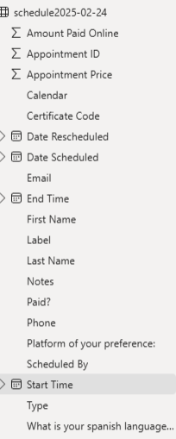
THE DATASET
To prepare for analysis, we began with the 'schedule2025-02-24' dataset, downloaded from Acuity Scheduling. This CSV file, containing 629 rows and 40 columns, required specific cleaning procedures, which we'll review now.
Column headers
The company was founded and started collecting data in January 2021, the dataset was downloaded on 2/24/2025.

Slide 5
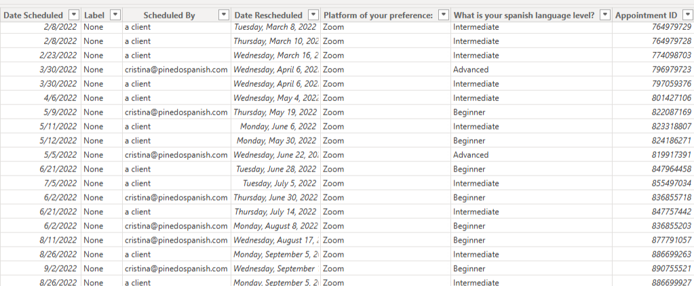
DATA CLEANING
Using Power Query, we handled missing data by imputing '0' for integer columns and 'None' for string columns, ensuring a complete dataset for analysis.
For client privacy and security, Personally Identifiable Information (PII) has been excluded from all charts and visualizations in this presentation.

Slide 6
‘Amount Paid Online’
‘Appointment ID’
‘Appointment Price’
Integer
Date/time
‘Date Rescheduled’
‘Date Scheduled’
‘End time’
‘Start Time’
String
The rest of the columns
DATA VALIDATION
Data types were formatted as follows:

Slide 7
02
ACTIVITY MAP

Slide 8
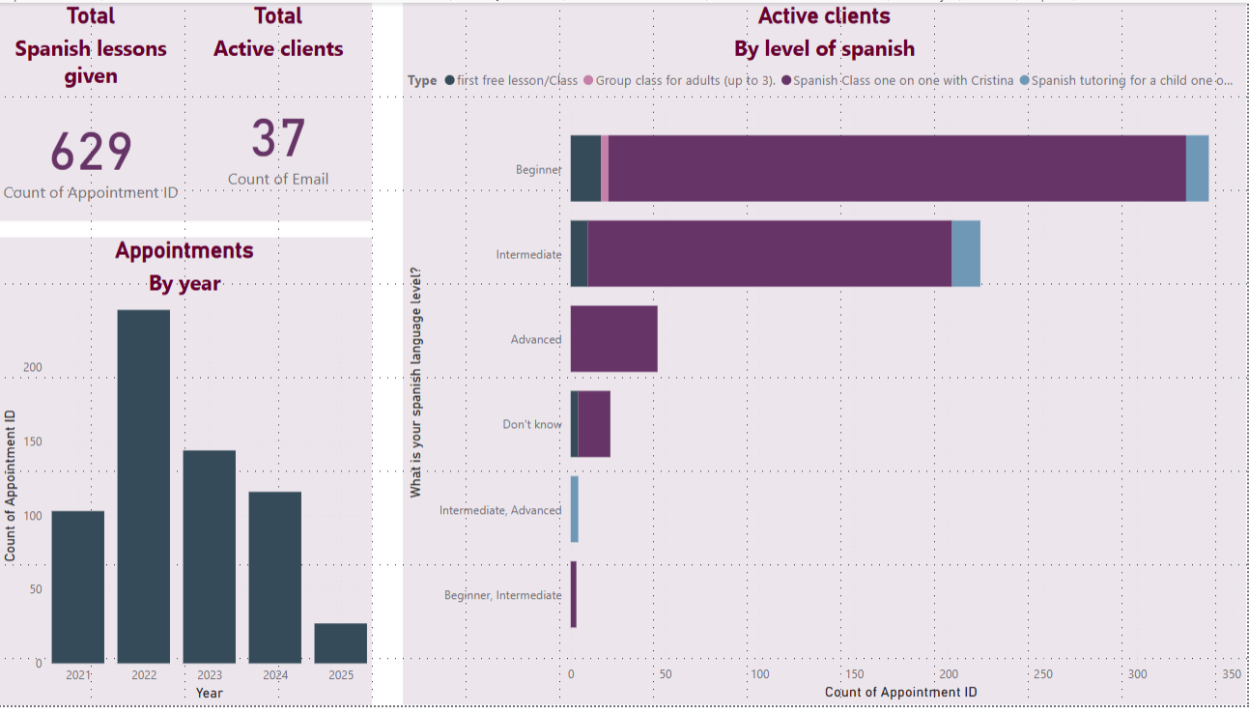
COMPANY SIZE
This dashboard allows for quick identification of key business trends. The bar charts visualize key data, and the KPI cards draw attention to critical metrics. Notably, the clustered bar chart highlights our most popular service packages, allowing us to focus on what is driving the most revenue.

Slide 9
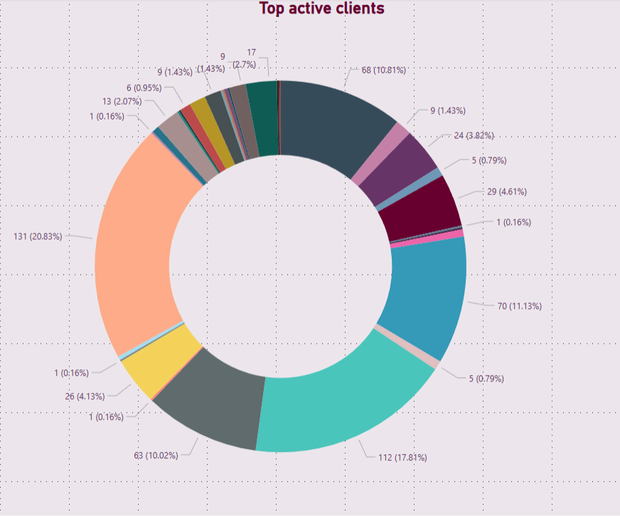
ACTIVE CLIENTS
This chart identifies our most active clients, providing a clear basis for implementing client recognition and loyalty initiatives.
Referral Rewards:
Offer a free class or a discount on a package for both the referrer and the new student.
Create a referral leaderboard with monthly or quarterly prizes.
Pinedo Spanish Proficiency Pathway:
Tiered Program: Bronze, Silver, Gold levels based on the number of classes taken.
Bronze: Bonus vocabulary lists, or digital flashcards.
Silver: Free access to monthly "conversation café" sessions.
Gold: Personalized learning plan review with the CEO, or a free one-on-one session.

Slide 10
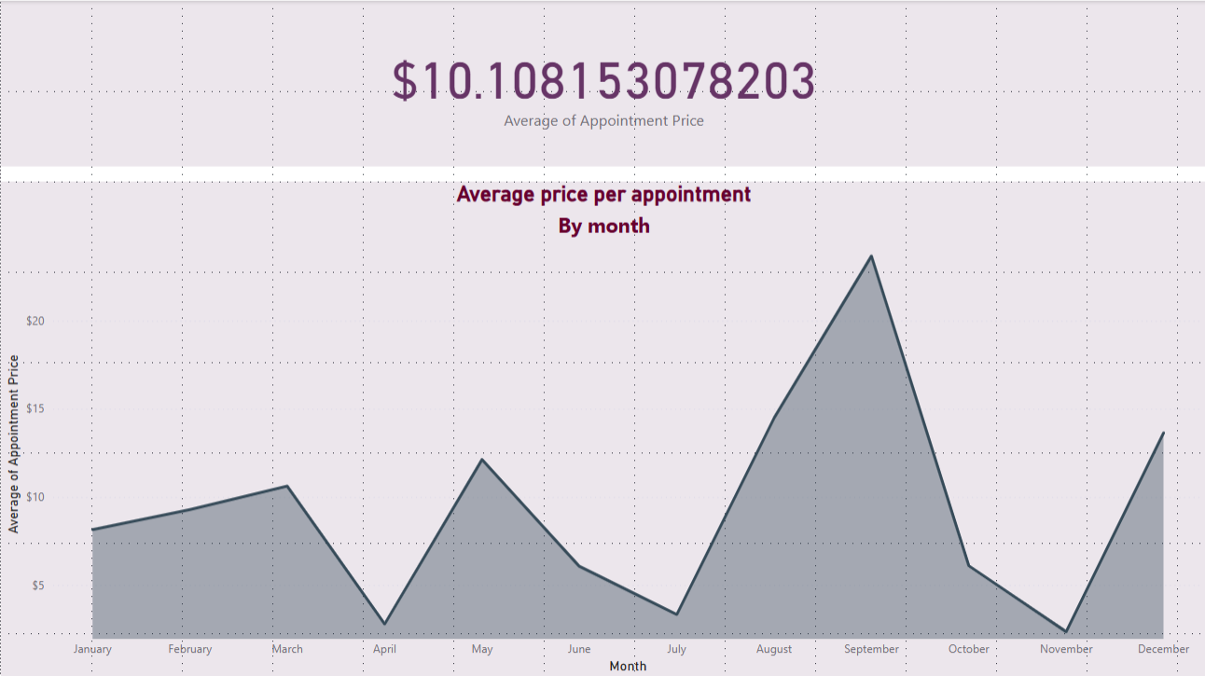
CURRENT COST OF BUSINESS
Average revenue per appointment shows significant variability across the months, as depicted in this stacked area chart. We see a peak of $23.66 in September and a low of $2.35 in November, with an annual average of $10.10. Further analysis is needed to understand these fluctuations
$23.66
$2.35

Slide 11
03
MARKETING IDEAS

Slide 12
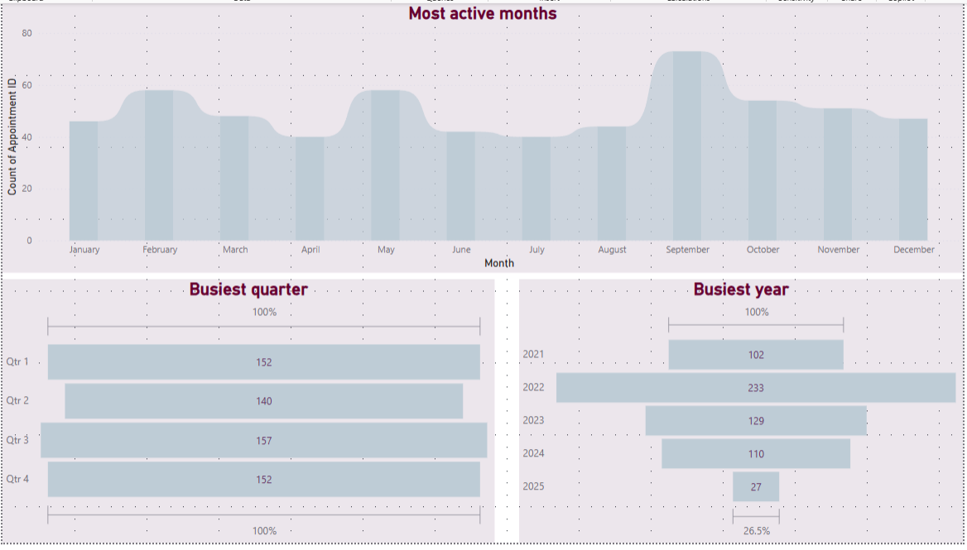
ACTIVITY
by
year / quarter / month
Our peak performance, as indicated by this ribbon chart, occurred in February, May, and September.

Slide 13



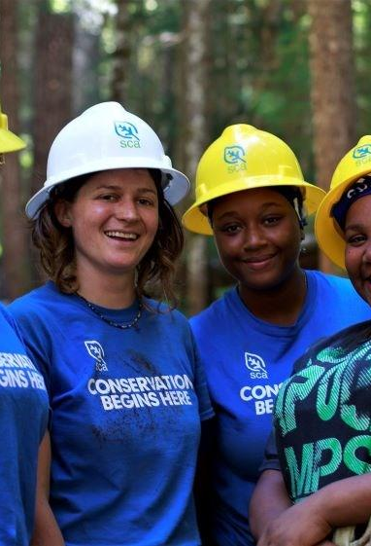
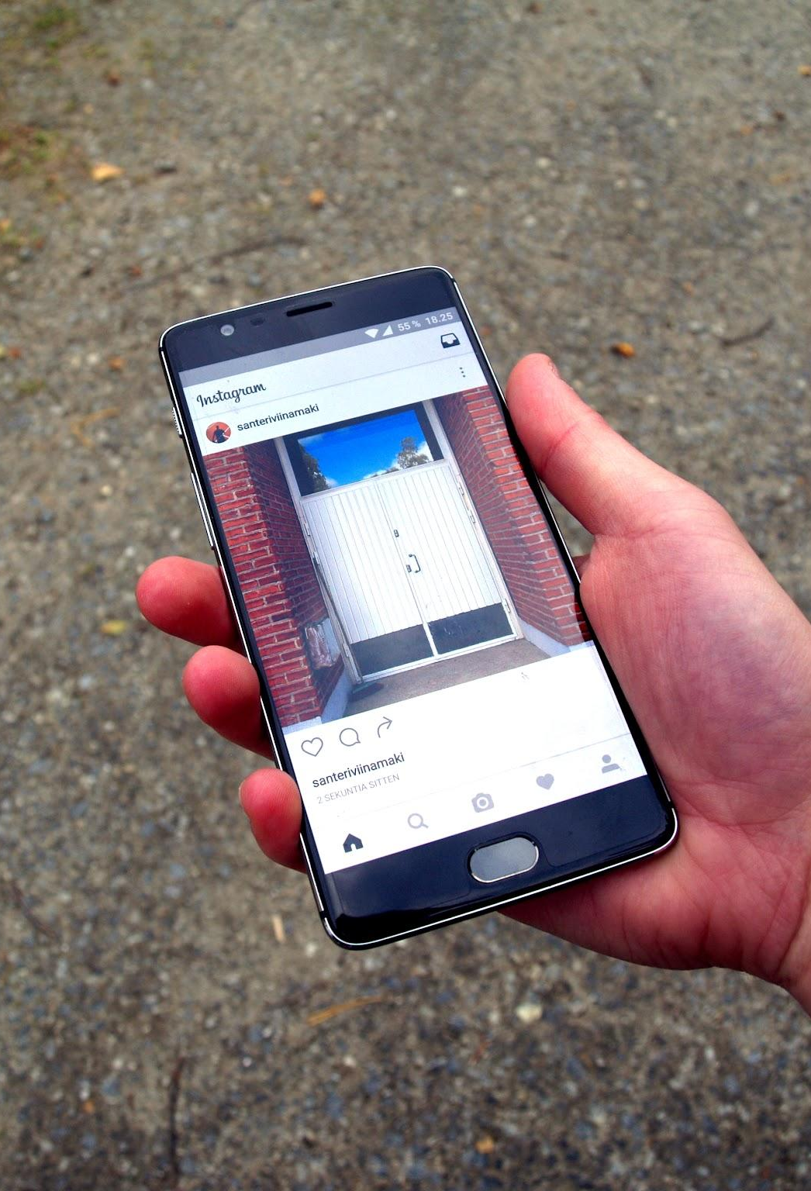
Step 1
Step 2
Step 3
Step 4
Step 5
Targeted Social Media Video Ads
Learn Spanish for Travel" Content Marketing
Online Spanish Language Learning Communities and Forums
Virtual Spanish Language Exchange" Partnerships
Google Ads with Targeted Keywords
IDEAS
These ideas focus on digital channels, content marketing, and community engagement, which are highly effective for reaching online learners.

Slide 14





Personalized communication
Consistent Value Delivery:
Proactive Engagement
Feedback and Improvement
Build a Community
Tailor interactions to individual client needs and preferences.
Ensure high-quality service and exceed expectations consistently.
Reach out regularly with relevant updates and offers.
Actively solicit client feedback and implement changes.
Foster connections and create a sense of belonging.
Recurring Revenue: Consistent students provide a stable income stream.
Word-of-Mouth Marketing: Satisfied clients are the best advocates, leading to new students.
Efficient Growth: Retaining existing clients is more cost-effective than acquiring new ones.
Deepened Learning: Extended engagement allows for greater student proficiency, reflecting positively on the company.
Community Building: Retained clients contribute to a strong, supportive learning community.
CLIENT RETENTION

Slide 15
04
ADVERTISING

Slide 16

“Creative without strategy is called 'art.' Creative with strategy is called 'advertising.”
Jef I. Richards.

Slide 17



February
May
September
When to Advertise
Average revenue
Average revenue
Average revenue
$640
$440
$1,450

Slide 18
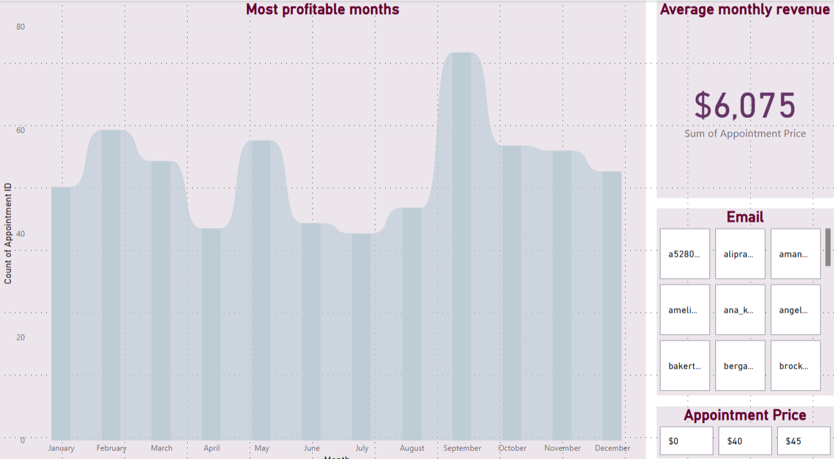
Here is why
This ribbon chart reveals our prime advertising periods. February, May, and September consistently demonstrate the highest engagement, indicating optimal times to maximize our outreach efforts.

Slide 19
05
FUTURE PROJECTS

Slide 20

ONLINE COURSES
Continuing the online course creation mentorship with Evergreen is vital for building passive income and ensuring the company's future success.

Slide 21

CLOSING
This presentation provided a comprehensive overview of Pinedo Spanish LLC's performance and strategic direction. We explored key data points, including client activity, revenue fluctuations, and advertising effectiveness, all visualized through insightful Power BI dashboards.
The analysis highlighted the importance of client retention, targeted advertising, and the strategic development of online courses through ongoing mentorship. Ultimately, the data-driven insights presented here underscore the company's commitment to growth, client satisfaction, and the expansion of its educational reach within the online Spanish learning market.

Slide 22
THANK YOU
Jesus Acevedo

